Slide 1
Learning to Ask Questions in Open-domain Conversational Systems with Typed Decoders
Advisor: Jia-Ling Koh
Presenter: Yin-Hsiang Liao
Source: ACL 2018
Data: 2018/10/09
ALLPPT.com _ Free PowerPoint Templates, Diagrams and Charts

Slide 2
Outline
Introduction
Methodology
Experiment
Conclusion

Slide 3
Introduction
Goal:
To enhance the interactiveness and persistence of human-machine interactions.
Goal of traditional QG tasks:
To seek information through a generated question.

Slide 4
Introduction
Uniqueness:
Questions in various patterns and about diverse yet relevant topics.
Defects of traditional QG tasks:
The information questioned on usually determines the pattern of questions.
E.g., Given person → Who-questions;
Given location → Where-questions.

Slide 5
Introduction
Uniqueness:
diverse yet relevant topics means this task requires to address more transitional topics of a given input.
Scene understanding is important.
E.g., I went to dinner with my friends → friends, cuisine, price, place or taste.
(scenario: dinner at a restaurant)
Defects of traditional QG tasks:
The information questioned on is pre-specified and paraphrasing is more required.
Universal but meaningless question, like ‘so what?’ and ‘what up?’, are often generated.

Slide 6
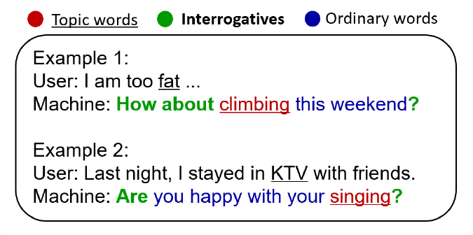
Introduction
Observation: a good question is a natural composition of interrogatives, topic word, and ordinary words.
Pattern
Syntax
Key information

Slide 7
Introduction
The three types of words will be used in proposed models in either implicit or explicit manners.

Slide 8
Outline
Introduction
Methodology
Experiment
Conclusion

Slide 9
Methodology
Question Definition:
X: input post, x1x2…xm
Y: natural and meaningful question, y1y2…yn

Slide 10
Methodology
Word types:
During training, the type of each word in a question is decided automatically.
20 interrogatives
Verbs and nouns in a question (response) are treated as topic words.
Others are ordinary words
During testing, using PMI to predict a few topic words for a given post.
At most 20 topic words, interrogatives are picked form a small dictionary.

Slide 11
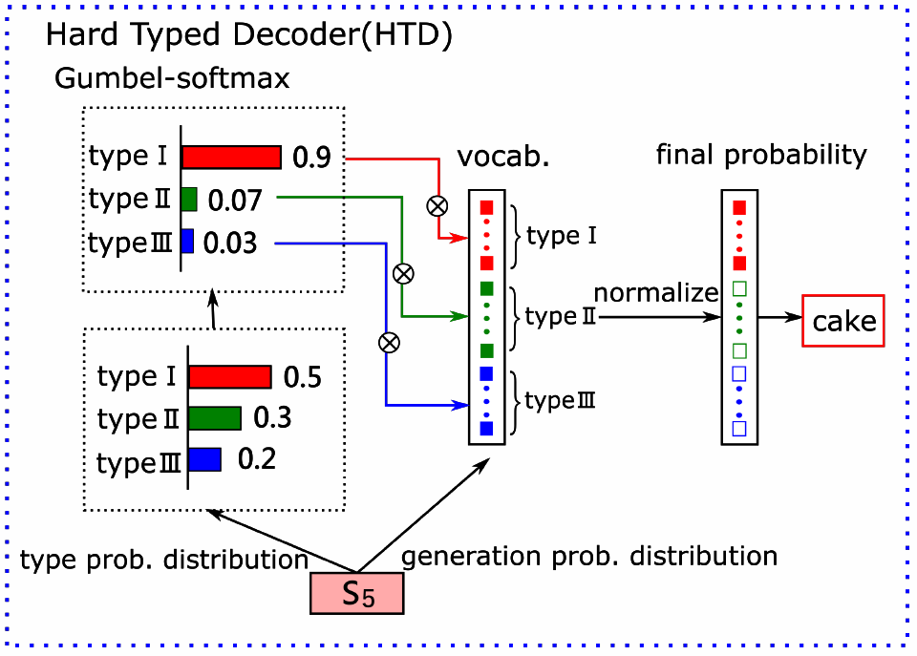
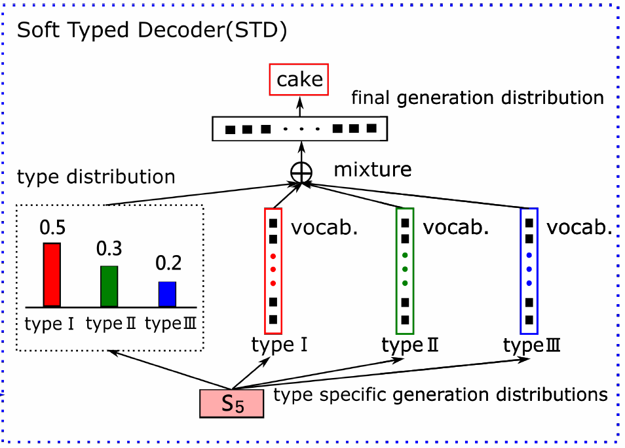
Methodology
Models’ Frameworks

Slide 12
Methodology
More on STD

Slide 13
Methodology
More on HTD

Slide 14
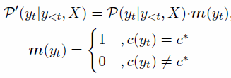
Methodology
Argmax(greedy)
Not differentiable
Replace m by:
differentiable

Slide 15
Methodology
Gumbel-Softmax

Slide 16
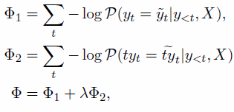
Methodology
Loss Function
Cross entropy

Slide 17
Outline
Introduction
Methodology
Experiment
Conclusion

Slide 18
Experiment
Dataset:
9 million post-response pairs from Weibo.
PMI: all
QG model: 491,000 pairs containing question. 5,000 for testing.

Slide 19
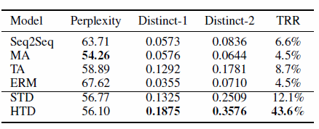
Experiment
Automatic evaluation
Metric: perplexity, distinct-1, distinct-2, TRR

Slide 20
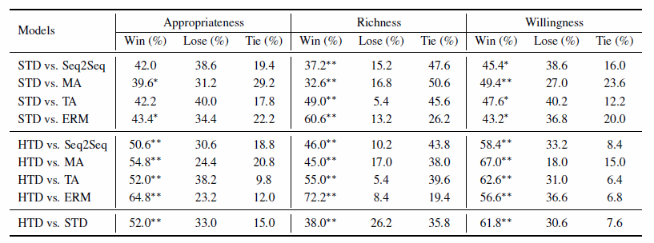
Experiment
Manual evaluation

Slide 21
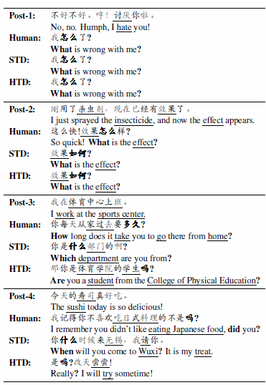
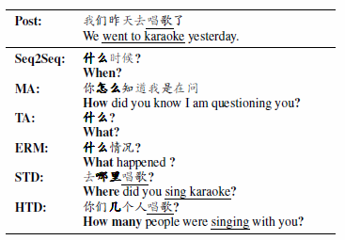
Experiment
Results

Slide 22
Outline
Introduction
Methodology
Experiment
Conclusion

Slide 23
Conclusion
1st study on QG in conversational system.
2 typed decoders to ask good questions.

